Slide 2
In order for a computer to solve a problem that relates to the real world, it first needs some way to represent the real world internally. In dealing with that internal representation, the computer is then able to solve problems.
The representation that is used to represent a problem is very important. In other words, the way in which the computer represents a problem, the variables it uses, and the operators it applies to those variables can make the difference between an efficient algorithm and an algorithm that doesn’t work at all. This is true of all Artificial Intelligence problems

Slide 3
The representation should be such that the computer does not waste too much time on pointless computations, it should be such that the representation really does relate to the problem that is being solved, and it should provide a means by which the computer can actually solve the problem.

Slide 4
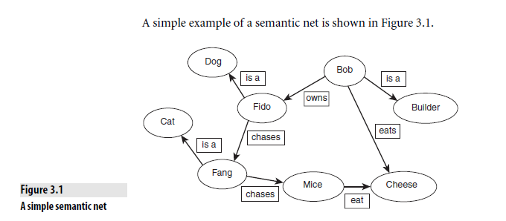

Slide 5
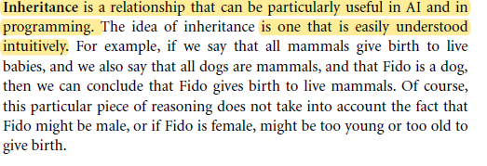

Slide 7
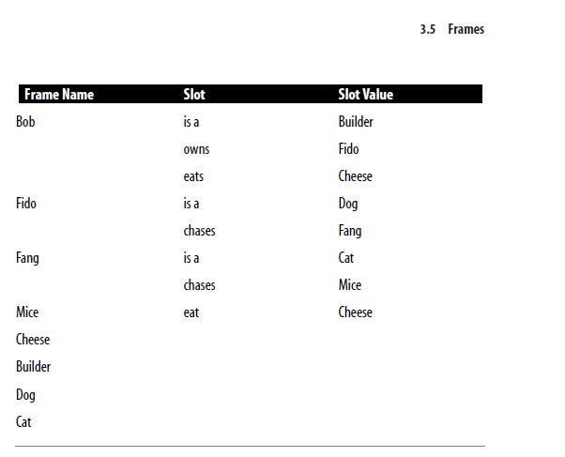

Slide 8
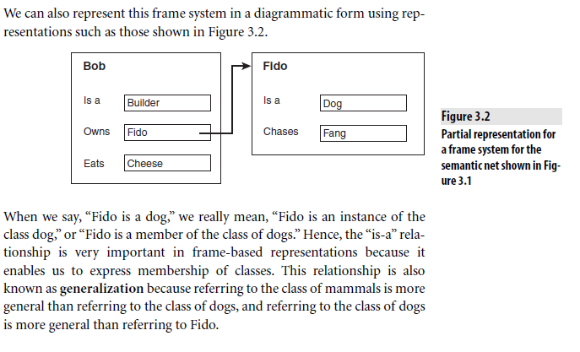

Slide 11
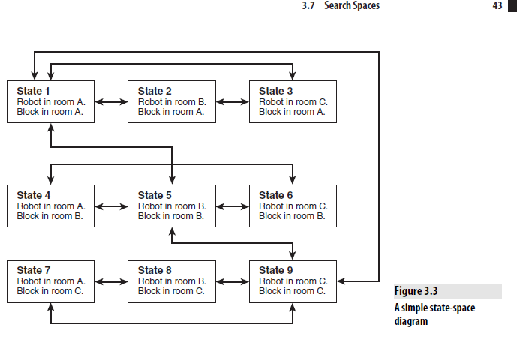

Slide 12
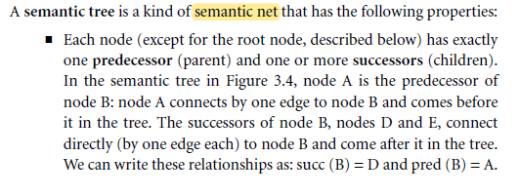

Slide 13
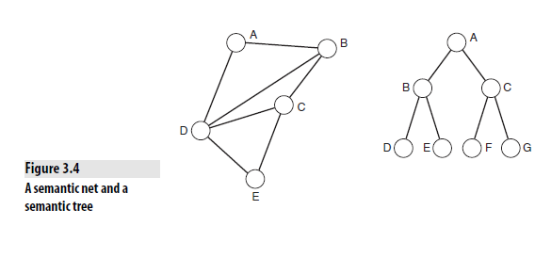

Slide 14
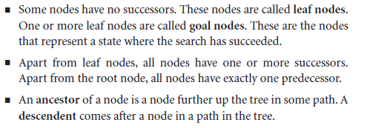

Slide 17
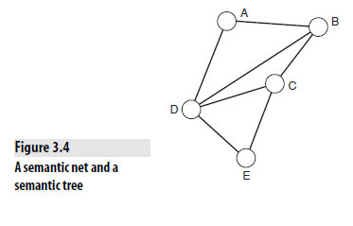
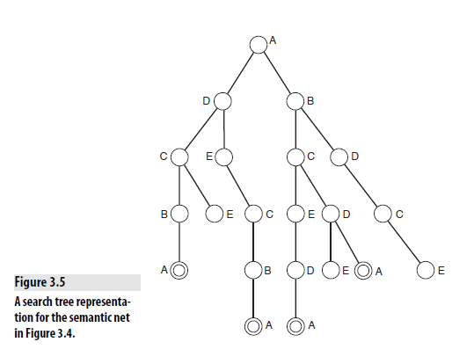

Slide 18
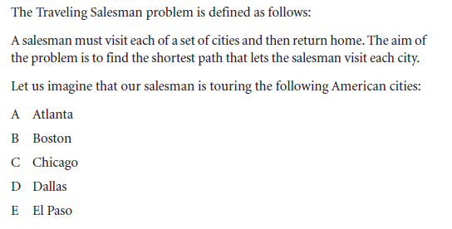

Slide 19
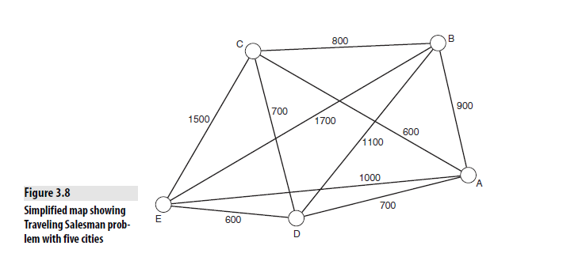

Slide 20
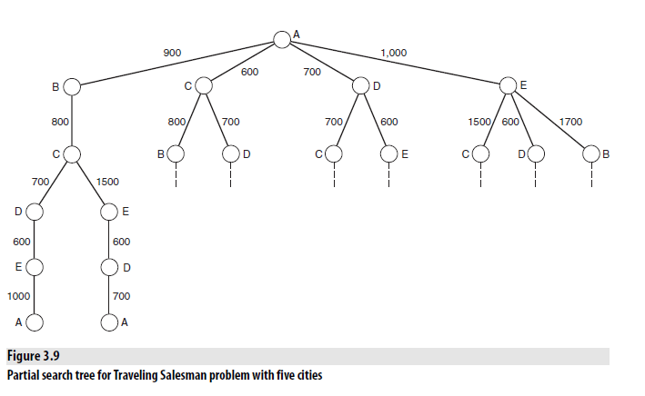

Slide 24
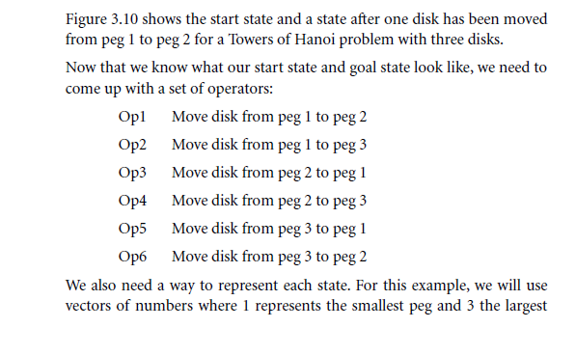

Slide 25
